Slide 1
Module 2

Slide 2
Module 2
Data Types – Primitive Data Types, Character String Types, User-Defined Ordinal Types, Array Types, Record Types, List Types, Pointer & Reference Types,
Type Checking, Strong Typing, Type Equivalence.
Expressions – Arithmetic Expressions, Overloaded Operators, Type Conversions, Relational and Boolean Expressions, Short-Circuit Evaluation.
Assignment- Assignment Statements, Mixed-mode Assignment

Slide 3
Datatypes
A data type defines a collection of data values and a set of predefined operations on those values.
Computer programs produce results by manipulating data.
An important factor in determining the ease with which they can perform this task is how well the data types available in the language being used match the objects in the real-world of the problem being addressed.
Therefore, it is crucial that a language supports an appropriate collection of data types and structures

Slide 4
A descriptor is the collection of the attributes of a variable
An object represents an instance of a user-defined (abstract data) type
One design issue for all data types:
What operations are defined and how are they specified?

Slide 5
Primitive Data Types
Almost all programming languages provide a set of primitive data types
Primitive data types: Those not defined in terms of other data types
Some primitive data types are merely reflections of the hardware
Others require only a little non-hardware support for their implementation

Slide 6
1. Numeric Types
1.1 Integer
Almost always an exact reflection of the hardware so the mapping is trivial
There may be as many as eight different integer types in a language
Java‘s signed integer sizes: byte, short, int, long
A signed integer value is represented in a computer by a string of bits, with one of the bits (typically the leftmost) representing the sign.
A negative integer could be stored in sign-magnitude notation. However, twos complement method etc are used to store negative integers, which is convenient for addition and subtraction

Slide 7
1.2 Floating - Point
Most newer machines use the IEEE Floating-Point Standard 754 format.
The float type is the standard size, usually being stored in four bytes of memory.
The double type is provided for situations where larger fractional parts and/or a larger range of exponents is needed.
Double-precision variables usually occupy twice as much storage as float variables and provide at least twice the number of bits of fraction
The collection of values that can be represented by a floating-point type is defined in terms of precision and range.
Precision is the accuracy of the fractional part of a value, measured as the number of bits.
Range is a combination of the range of fractions and, more important, the range of exponents.

Slide 8
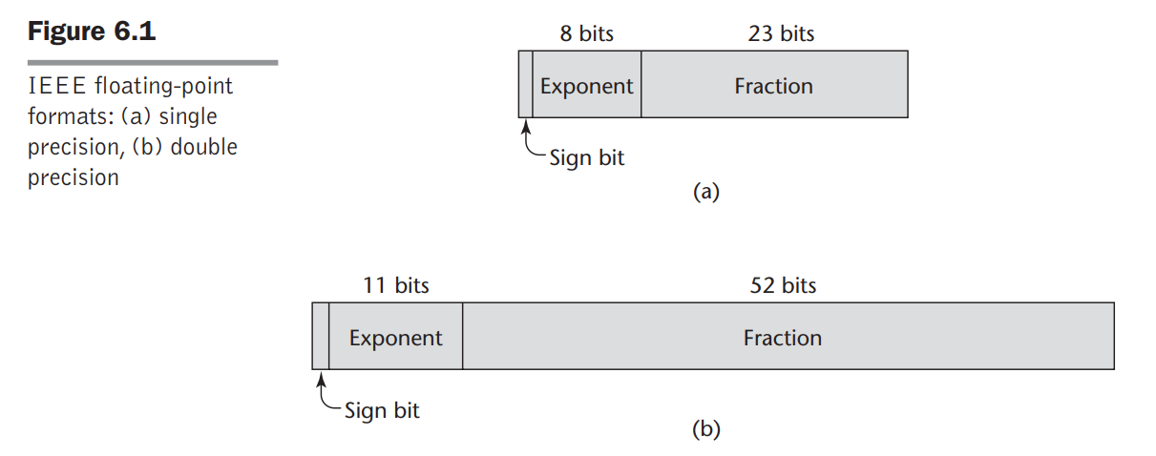

Slide 9
1.3 Complex
Some languages support a complex type, e.g., Fortran and Python
Each value consists of two floats, the real part and the imaginary part.
In Python, the imaginary part of a complex literal is specified by following it with a j or J.
Eg: (7 + 3j), where 7 is the real part and 3 is the imaginary part

Slide 10
1.4 Decimal
For business systems applications (money)
Decimal data types store a fixed number of decimal digits, with the decimal point at a fixed position in the value.
– Essential to COBOL
– C# offers a decimal data type
Decimal types are stored like character strings, using binary codes for the decimal digits. These representations are called binary coded decimal (BCD).
They take more storage than binary representations.
Advantage: accuracy
Disadvantages: limited range, wastes memory

Slide 11
2. Boolean Types
Simplest of all types
Range of values has only two elements, one for true and one for false
They were introduced in ALGOL 60 and have been included in most general-purpose languages designed since 1960.
Boolean types are often used to represent switches or flags in programs.
Could be implemented as bits, but often as bytes
A Boolean value could be represented by a single bit, but they are often stored in a byte.
Advantage: readability

Slide 12
3. Character Types
Stored as numeric coding
Most commonly used coding: ASCII
An alternative, 16-bit coding: Unicode
Includes characters from most natural languages
– Originally used in Java
– C# and JavaScript also support Unicode

Slide 13
Character String Types
Values are sequences of characters.
character strings are an essential type for all programs that do character manipulation
1. Design issues:
– Is it a primitive type or just a special kind of array?
– Should strings have static or dynamic length?

Slide 14
2. Strings and Their Operations
Typical operations:
– Assignment and copying
– Comparison (=, >, etc.)
- Catenation
– Substring reference – substring references are called slices.
–Pattern matching is a fundamental character string operation.
In some languages, pattern matching is supported directly in the language. In others, it is provided by a function or class library.

Slide 15
Character String Type in Certain Languages
If strings are not defined as a primitive type, string data is usually stored in arrays of single characters and referenced as such in the language.
C and C++ use char arrays to store character strings.
Many uses of strings and library functions use the convention that character strings are terminated with a special character, null, which is represented with zero. This is an alternative to maintaining the length of string variables.
SNOBOL4 (a string manipulation language)

Slide 16
Fortran and Python
– Primitive type with assignment and several operations
Java
– Primitive via the String class
Perl, JavaScript, Ruby, and PHP
– Provide built-in pattern matching, using regular expressions

Slide 17
There are several design choices regarding the length of string values.
First, the length can be static and set when the string is created. Such a string is called a static length string.
Static: COBOL, Java‘s String class
The second option is to allow strings to have varying length up to a declared and fixed maximum set by the variable’s definition, as exemplified by the strings in C and the C-style strings of C++.
These are called limited dynamic length strings

Slide 18
Limited Dynamic Length: C and C++
– In these languages, a special character is used to indicate the end of a string‘s characters, rather than maintaining the length
The third option is to allow strings to have varying length with no maximum, as in JavaScript, Perl, and the standard C++ library. These are called dynamic length strings.
Dynamic (no maximum): SNOBOL4, Perl, JavaScript
Ada supports all three string length options

Slide 19
Evaluation
String types are important to the writability of a language.
As a primitive type with static length, they are inexpensive to provide
Dynamic length is nice, but is it worth the expense?
Implementation of Character String Types

Slide 20
Implementation of Character String Types
A descriptor for a static character string type, which is required only during compilation, has three fields.
The first field of every descriptor is the name of the type
The second field is the type’s length (in characters).
The third field is the address of the first character.
Limited dynamic strings require a run-time descriptor to store both the fixed maximum length and the current length

Slide 21
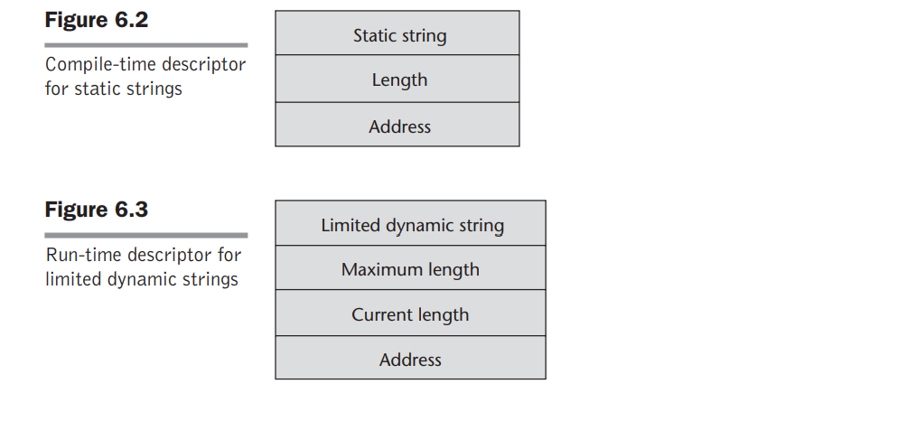

Slide 22
Dynamic length strings require a simpler run-time descriptor because only the current length needs to be stored.
Although we depict descriptors as independent blocks of storage, in most cases, they are stored in the symbol table

Slide 23
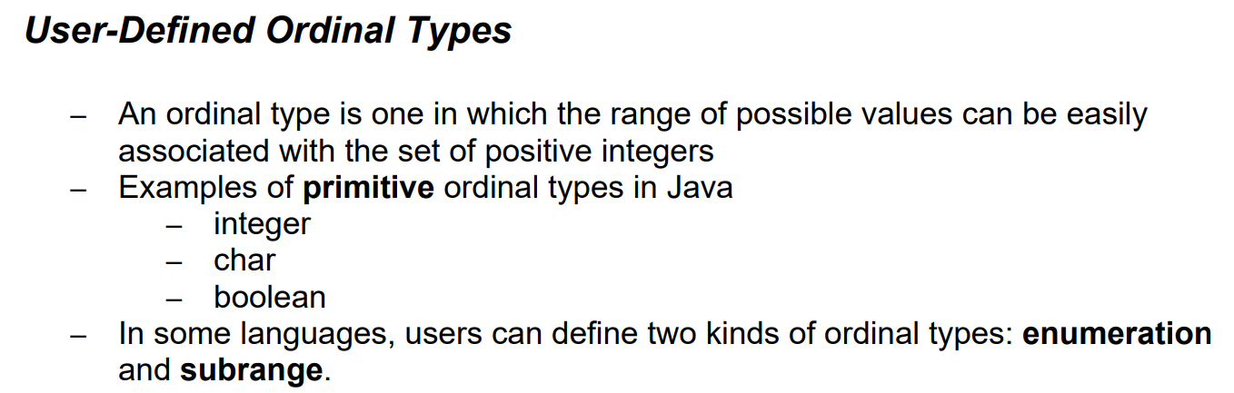

Slide 24
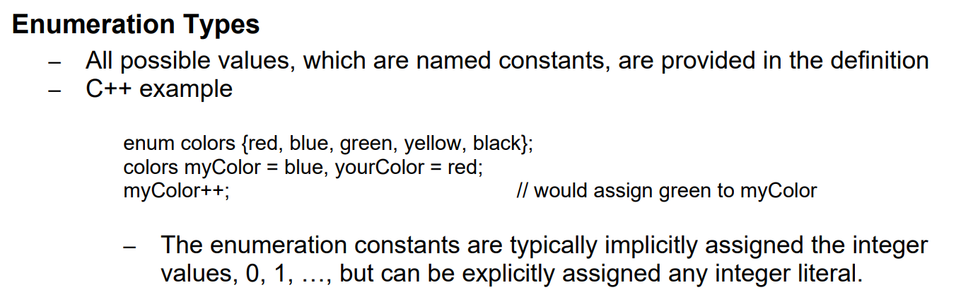

Slide 25
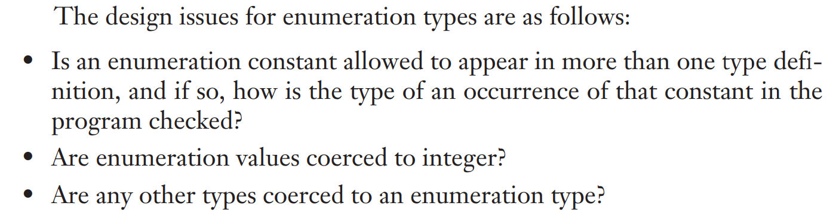

Slide 26
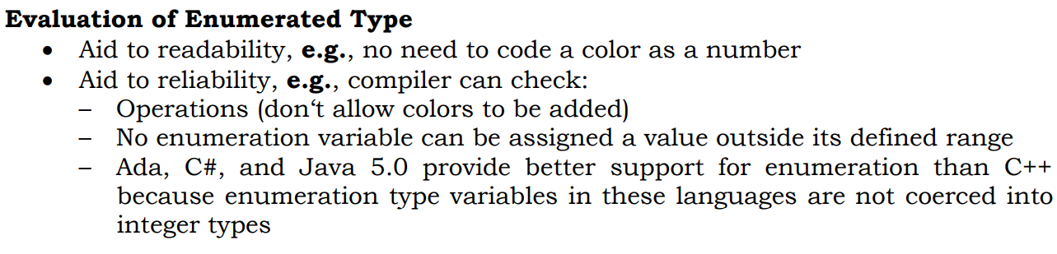

Slide 27
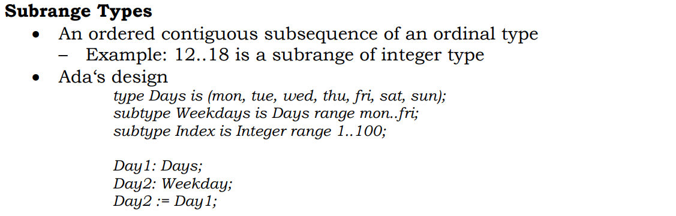

Slide 28
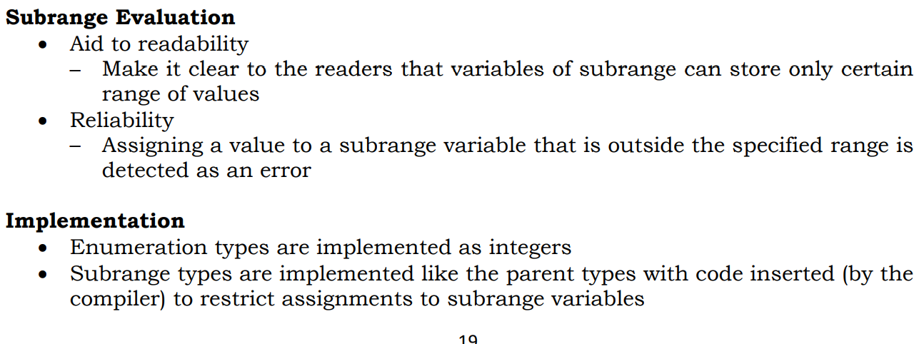

Slide 29
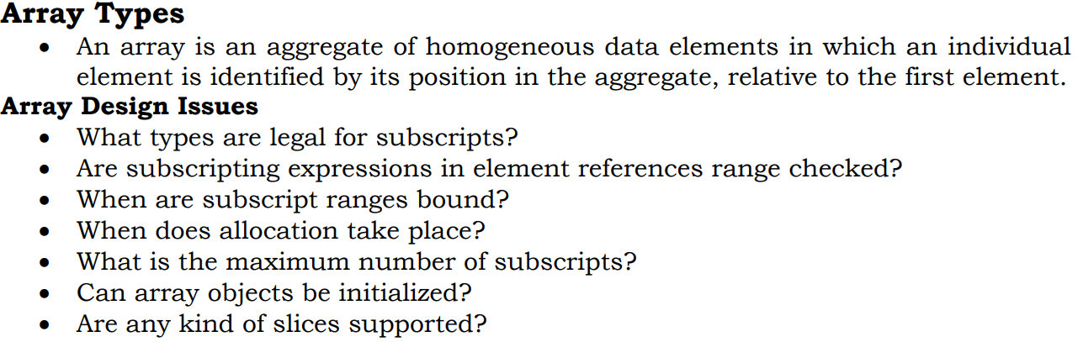

Slide 30
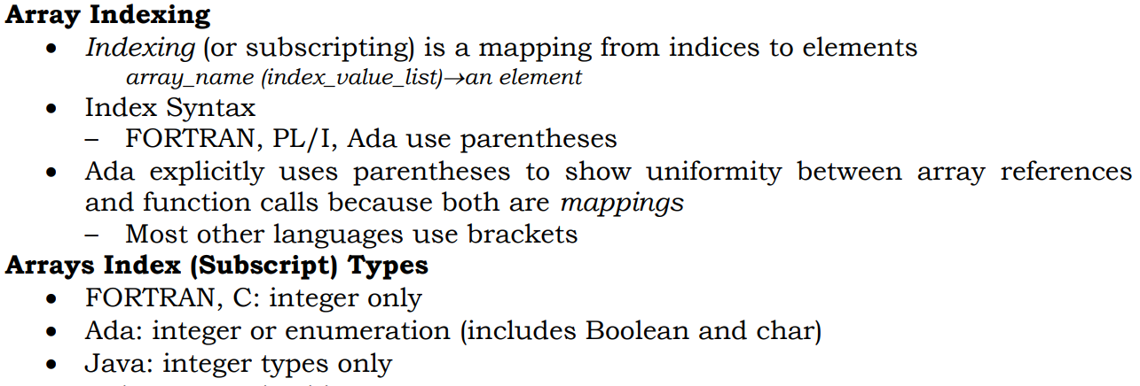
Arrays and Indices

Slide 31
Subscript Bindings and Array Categories
There are five categories of arrays, based on the binding to subscript ranges, the binding to storage, and from where the storage is allocated
1. Static array 2. Fixed stack-dynamic array 3. Stack dynamic array 4. Fixed heap dynamic array 5. Heap dynamic array

Slide 32
Static array
A static array is one in which the subscript ranges are statically bound and storage allocation is static (done before run time).
The advantage of static arrays is efficiency:
No dynamic allocation or deallocation is required.
The disadvantage is that the storage for the array is fixed for the entire execution time of the program
Int a[10];

Slide 33
Fixed stack-dynamic array
A fixed stack-dynamic array is one in which the subscript ranges are statically bound, but the allocation is done at declaration elaboration time during execution.
The advantage of fixed stack-dynamic arrays over static arrays is space efficiency
You know the size of your array at compile time, but allow it to be allocated automatically on the stack (the size is fixed at compile time but the storage is allocated when you enter its scope, and released when you leave it)

Slide 34
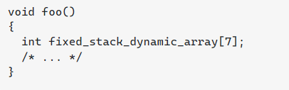
A large array in one subprogram can use the same space as a large array in a different subprogram, as long as both subprograms are not active at the same time.
The same is true if the two arrays are in different blocks that are not active at the same time.
The disadvantage is the required allocation and deallocation time

Slide 35
Stack dynamic array
A stack-dynamic array is one in which both the subscript ranges and the storage allocation are dynamically bound at elaboration time.
Once the subscript ranges are bound and the storage is allocated, however, they remain fixed during the lifetime of the variable.
The advantage of stack-dynamic arrays over static and fixed stack-dynamic arrays is flexibility.
The size of an array need not be known until the array is about to be used.
You don't know the size until runtime.

Slide 36
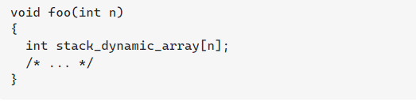

Slide 37
Fixed heap-dynamic array
A fixed heap-dynamic array is similar to a fixed stack-dynamic array, in that the subscript ranges and the storage binding are both fixed after storage is allocated.
The differences are that both the subscript ranges and storage bindings are done when the user program requests them during execution, and the storage is allocated from the heap, rather than the stack.

Slide 38
Fixed heap-dynamic array
The advantage of fixed heap-dynamic arrays is flexibility—the array’s size always fits the problem.
The disadvantage is allocation time from the heap, which is longer than allocation time from the stack

Slide 39
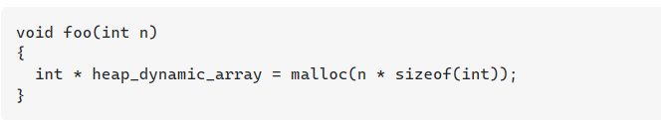
Heap-dynamic array
A heap-dynamic array is one in which the binding of subscript ranges and storage allocation is dynamic and can change any number of times during the array’s lifetime.
The advantage of heap-dynamic arrays over the others is flexibility:
Arrays can grow and shrink during program execution as the need for space changes.
The disadvantage is that allocation and deallocation take longer and may happen many times during execution of the program.

Slide 40
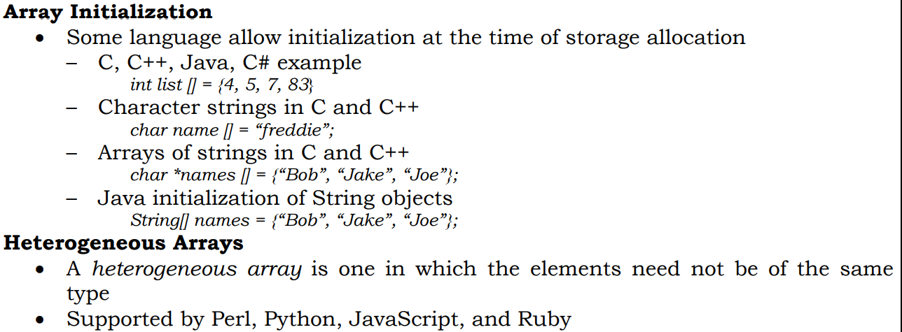

Slide 41
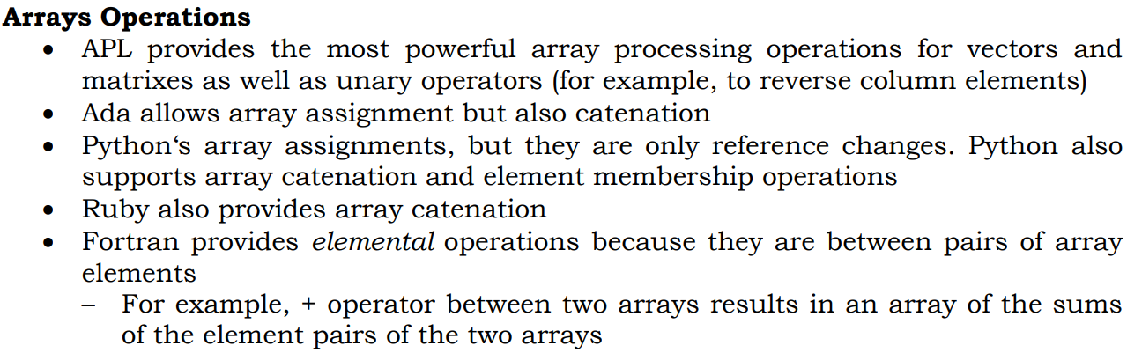

Slide 42
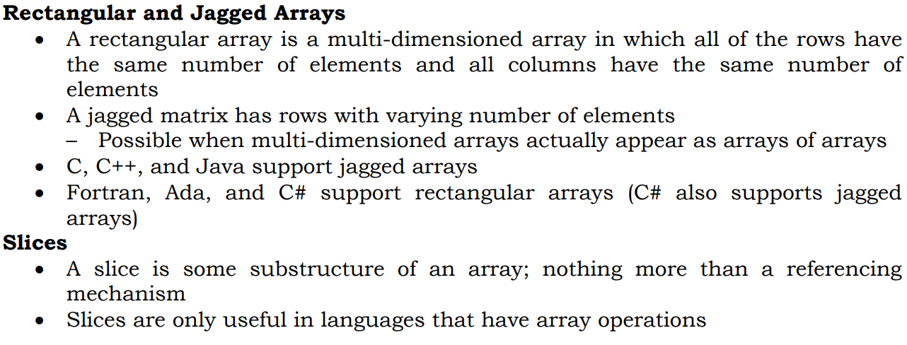

Slide 43
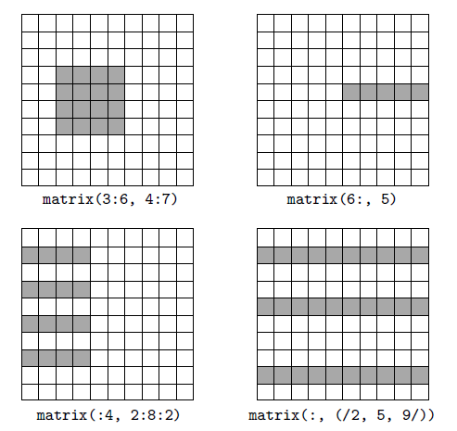
Slicing In Fortran 90

Slide 44
Perl supports slices of two forms, a list of specific subscripts or a range of subscripts.
For example, @list[1..5] = @list2[3, 5, 7, 9, 13];
Ruby supports slices with the slice method of its Array object, which can take three forms of parameters.
A single integer expression parameter is interpreted as a subscript, in which case slice returns the element with the given subscript.

Slide 45
If slice is given two integer expression parameters, the first is interpreted as a beginning subscript and the second is interpreted as the number of elements in the slice. For example, suppose list is defined as follows:
list = [2, 4, 6, 8, 10]
list.slice(2, 2) returns [6, 8]
The third parameter form for slice is a range, which has the form of an integer expression, two periods, and a second integer expression.
With a range parameter, slice returns an array of the element with the given range of subscripts.
For example, list.slice(1..3) returns [4, 6, 8].

Slide 46
Implementation of Array Types
Implementing arrays requires considerably more compile-time effort than does implementing primitive types.
The code to allow accessing of array elements must be generated at compile time.
At run time, this code must be executed to produce element addresses.

Slide 47
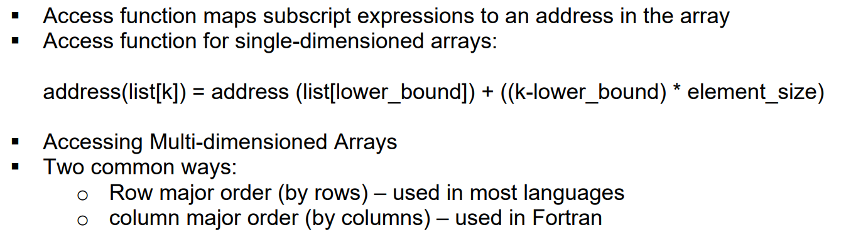

Slide 48
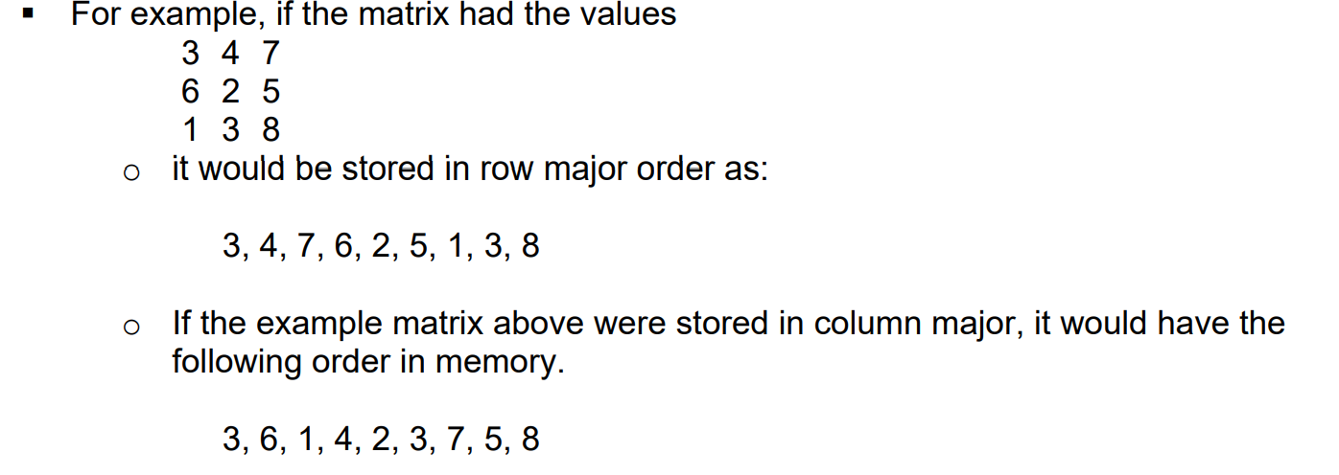

Slide 49
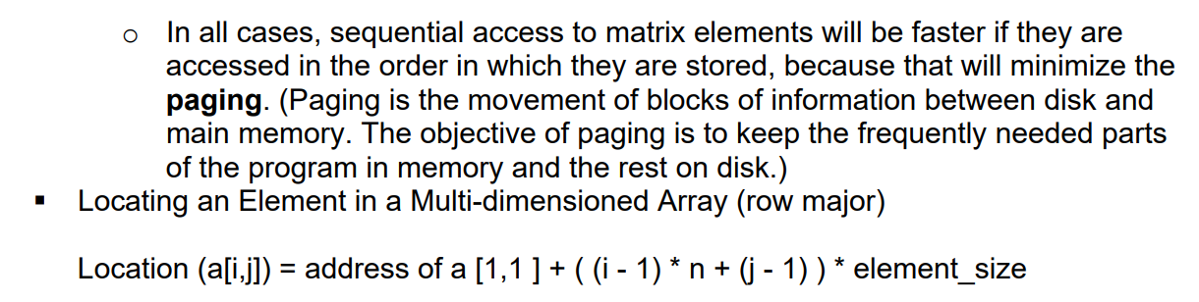
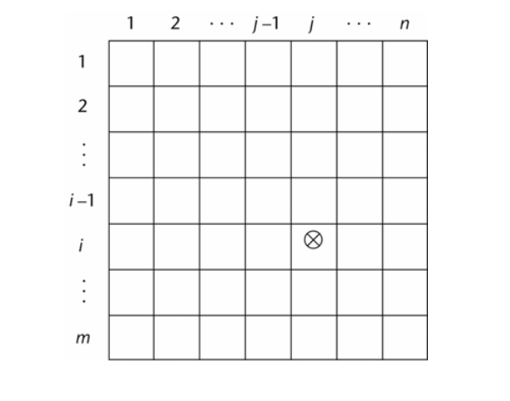

Slide 50
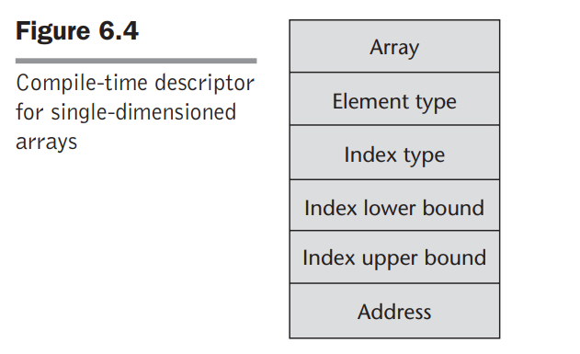

Slide 51
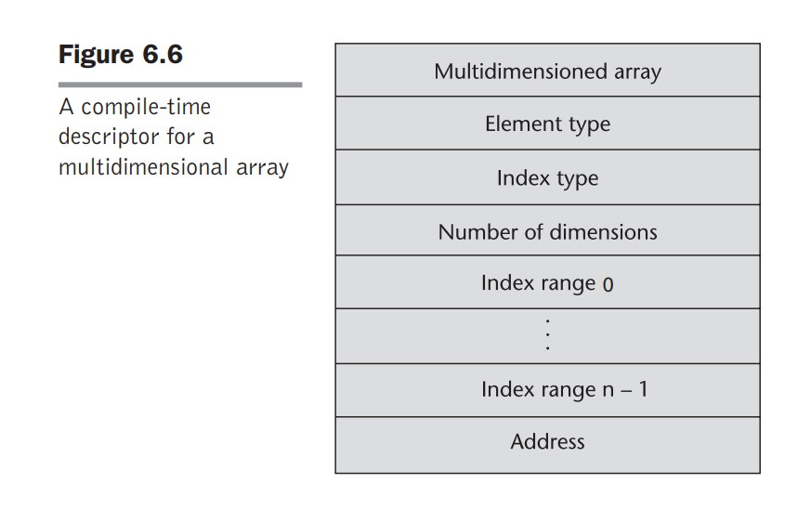

Slide 52
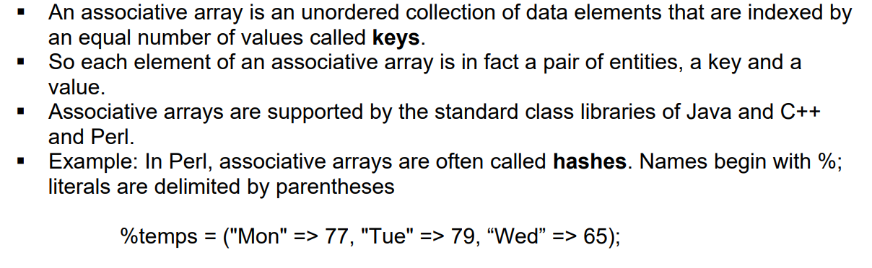
Associative Arrays

Slide 53
Each hash element consists of two parts: a key, which is a string, and a value, which is a scalar (number, string, or reference).
Hashes can be set to literal values with the assignment statement, as in
%salaries = ("Gary" => 75000, "Perry" => 57000, "Mary" => 55750, "Cedric" => 47850);

Slide 54
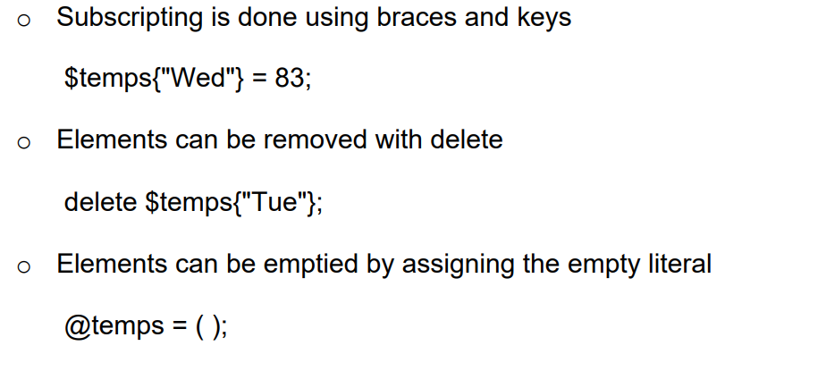

Slide 55
The exists operator returns true or false, depending on whether its operand key is an element in the hash.
if (exists $salaries{"Shelly"})
The keys operator, when applied to a hash, returns an array of the keys of the hash.
The values operator does the same for the values of the hash.
The each operator iterates over the element pairs of a hash.

Slide 56
Loop Through an Associative Array
<?php $age = array("Peter"=>"35", "Ben"=>"37", "Joe"=>"43"); foreach($age as $x => $x_value) { echo "Key=" . $x . ", Value=" . $x_value; echo "<br>"; } ?>

Slide 57
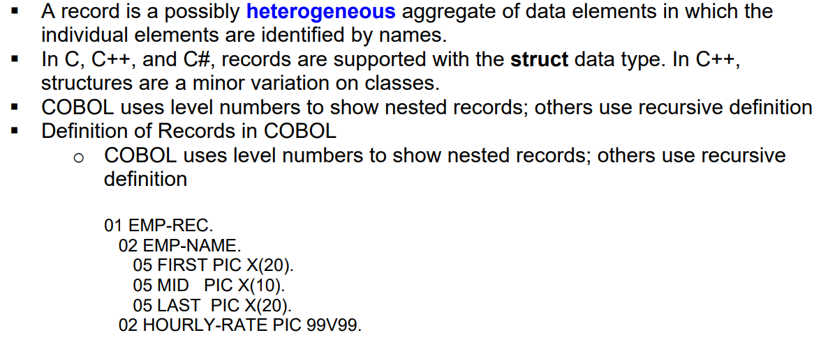
Record Types

Slide 58
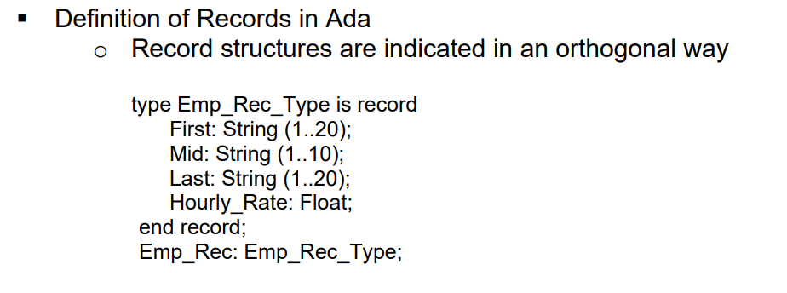
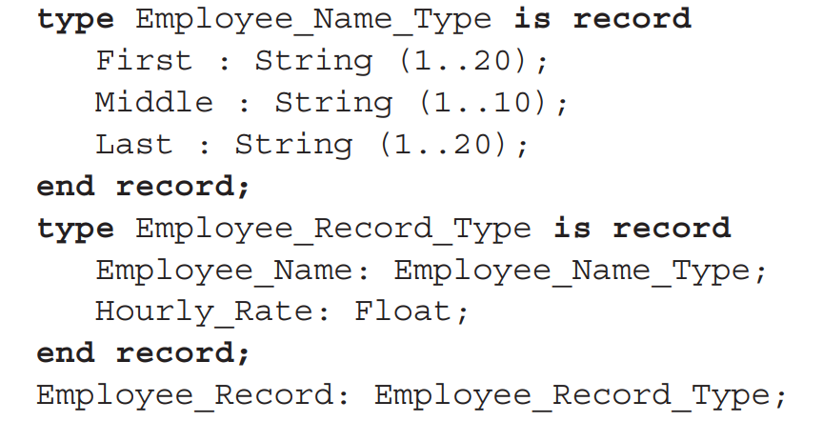

Slide 59
The following design issues are specific to records:
What is the syntactic form of references to fields ?
Are elliptical references allowed ?

Slide 60
Fully qualified reference to a record field is one in which all intermediate record names, from the largest enclosing record to the specific field, are named in the reference.
Both the COBOL and the Ada example field references above are fully qualified.
COBOL allows elliptical references to record fields.
In an elliptical reference, the field is named, but any or all of the enclosing record names can be omitted, as long as the resulting reference is unambiguous in the referencing environment.

Slide 61
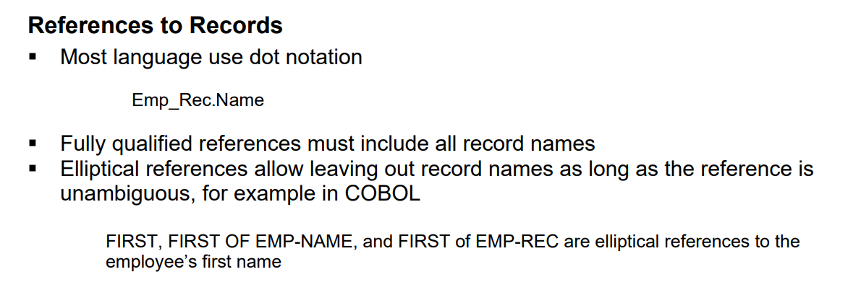
For example, the MIDDLE field in the COBOL record example above can be referenced with
MIDDLE OF EMPLOYEE-NAME OF EMPLOYEE-RECORD
Most of the other languages use dot notation for field references
Employee_Record.Employee_Name.Middle

Slide 62
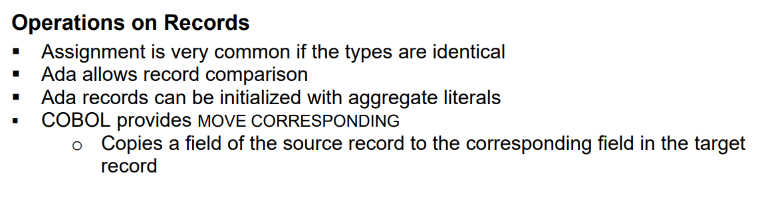

Slide 63
Evaluation
Records are used when the collection of data values is heterogeneous and the different fields are not processed in the same way.
Also, the fields of a record often need not be processed in a particular order.
Field names are like literal, or constant, subscripts. Because they are static, they provide very efficient access to the fields.
Dynamic subscripts could be used to access record fields, but it would disallow type checking and would also be slower

Slide 64
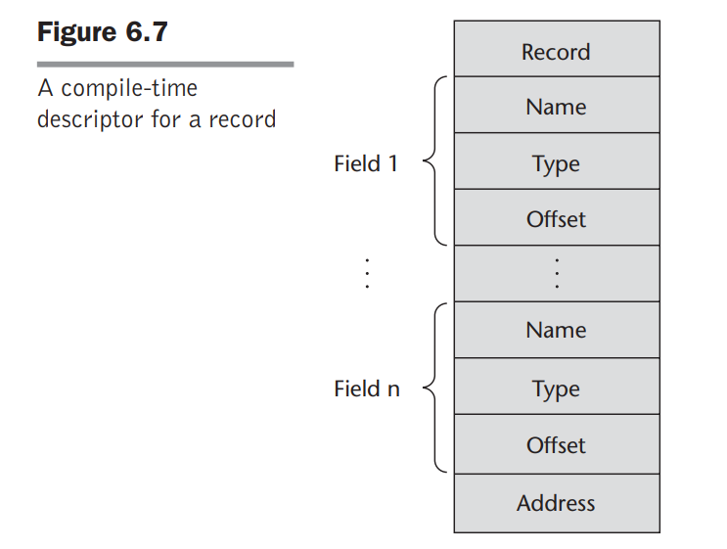

Slide 65
Union
A union is a type whose variables may store different type values at different times during program execution
C and C++ provide union constructs in which there is no language support for type checking.
In C and C++, the union construct is used to specify union structures.
The unions in these languages are called free unions, because programmers are allowed complete freedom from type checking in their use.

Slide 66
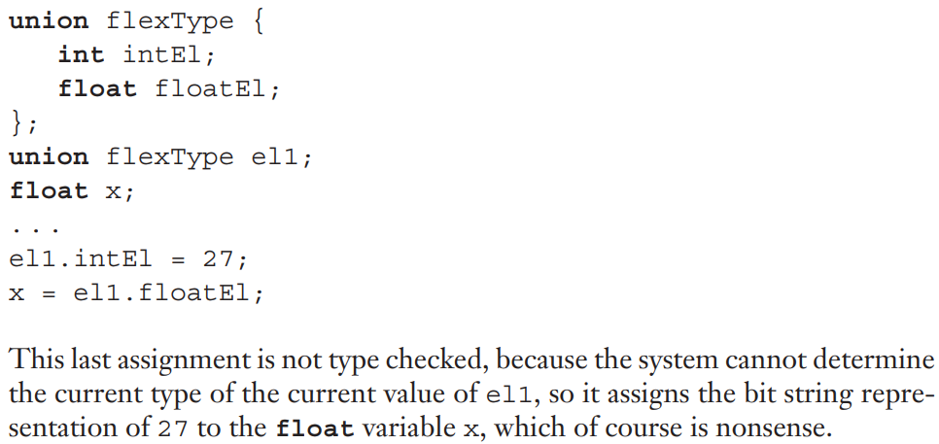

Slide 67
Type checking of unions requires that each union construct include a type indicator.
Such an indicator is called a tag, or discriminant, and a union with a discriminant is called a discriminated union.
The first language to provide discriminated unions was ALGOL 68. They are now supported by Ada, ML, Haskell, and F#

Slide 68
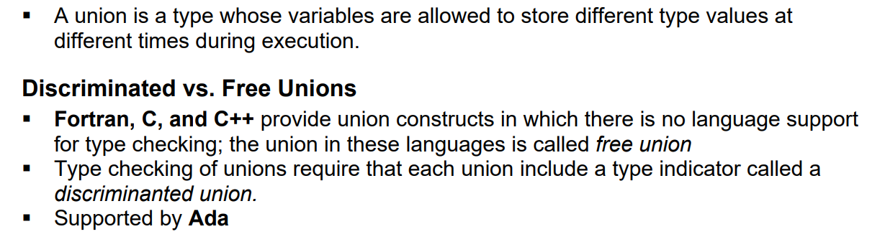
Unions Types

Slide 69
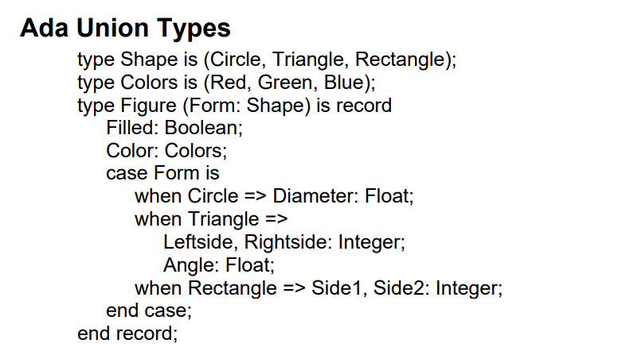

Slide 70
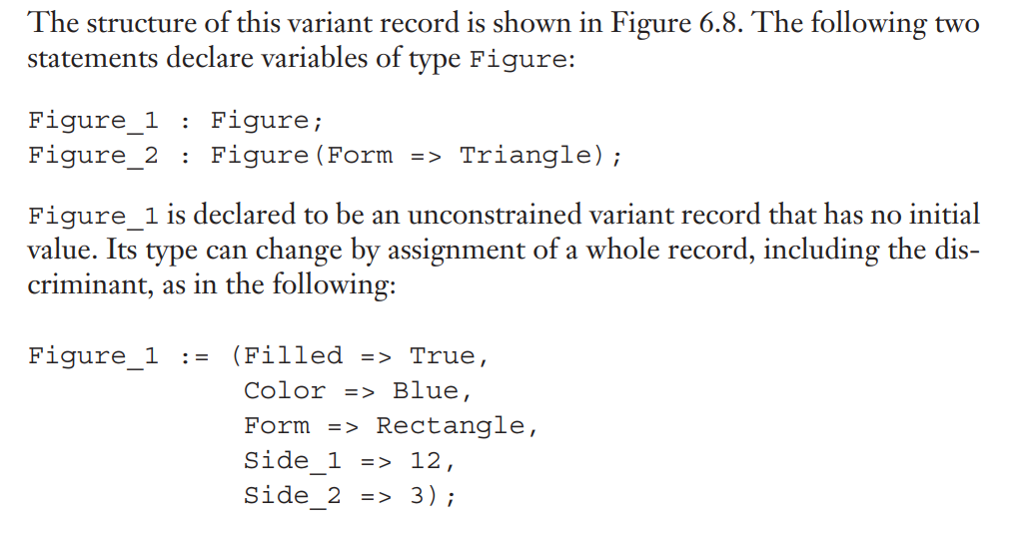

Slide 71
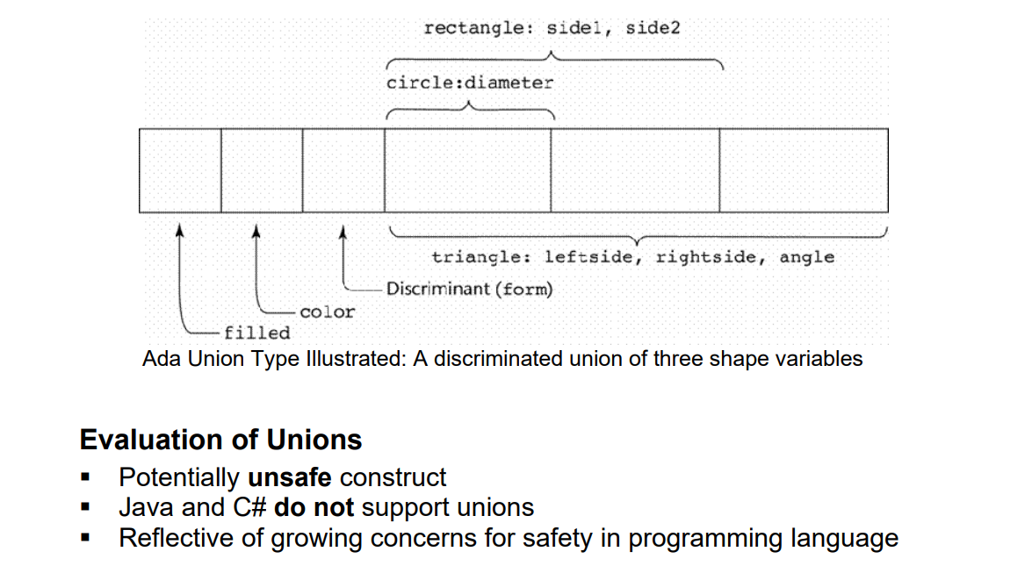

Slide 72
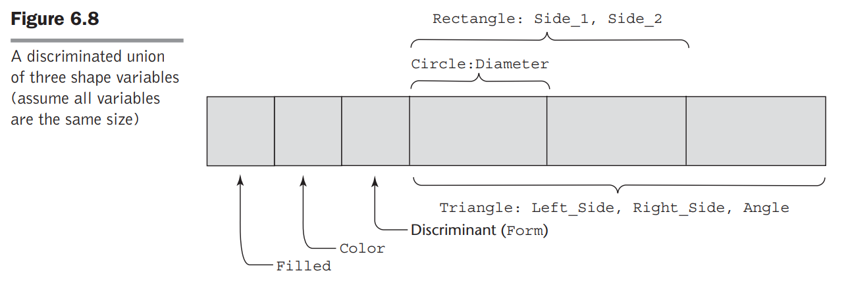

Slide 73
Evaluation
Unions are potentially unsafe constructs in some languages.
They are one of the reasons why C and C++ are not strongly typed:
These languages do not allow type checking of references to their unions.
On the other hand, unions can be safely used, as in their design in Ada, ML, Haskell, and F#.

Slide 74
Implementation of Union Types
Unions are implemented by simply using the same address for every possible variant.
Sufficient storage for the largest variant is allocated.
The tag of a discriminated union is stored with the variant in a recordlike structure.

Slide 75
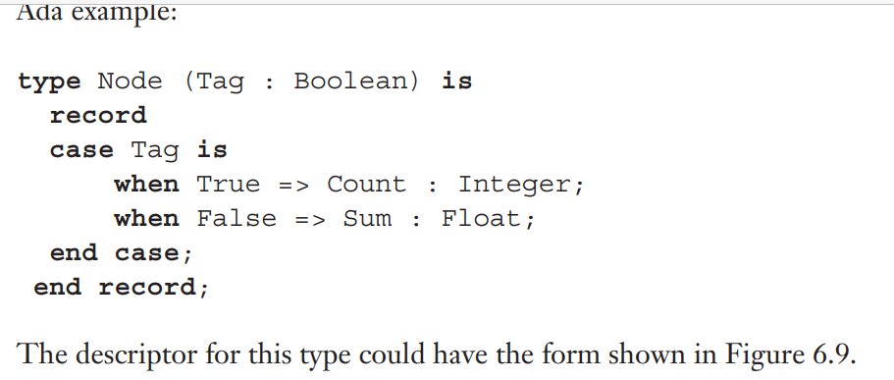

Slide 76
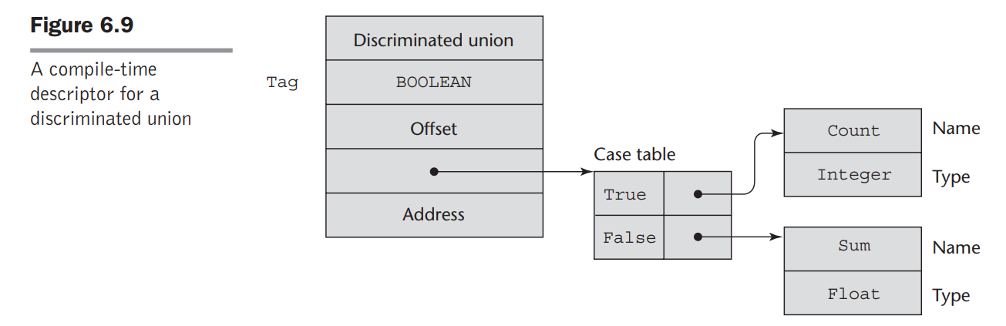

Slide 77
List Types
Lists were first supported in the first functional programming language, LISP.
They have always been part of the functional languages, but in recent years they have found their way into some imperative languages.
Lists in Scheme and Common LISP are delimited by parentheses and the elements are not separated by any punctuation.
For example
(A B C D)
Nested lists have the same form,
so we could have (A (B C) D)

Slide 78
Data and code have the same syntactic form in LISP and its descendants.
If the list (A B C) is interpreted as code, it is a call to the function A with parameters B and C.
The fundamental list operations in Scheme are two functions that take lists apart and two that build lists.
The CAR function returns the first element of its list parameter.
For example, consider the following example:
(CAR '(A B C)) - Returns A
The quote before the parameter list is to prevent the interpreter from considering the list a call to the A function with the parameters B and C, in which case it would interpret it.

Slide 79
The CDR function returns its parameter list minus its first element. For example,
Consider the following example:
(CDR '(A B C))
This function call returns the list (B C)
Common LISP also has the functions FIRST (same as CAR), SECOND, . . . , TENTH, which return the element of their list parameters that is specified by their names

Slide 80
In Scheme and Common LISP, new lists are constructed with the CONS and LIST functions.
The function CONS takes two parameters and returns a new list with its first parameter as the first element and its second parameter as the remainder of that list.
For example, consider the following
(CONS 'A '(B C)) – This call returns the new list (A B C).

Slide 81
The LIST function takes any number of parameters and returns a new list with the parameters as its elements.
For example, consider the following call to LIST:
(LIST 'A 'B '(C D))
This call returns the new list (A B (C D)).
ML has lists and list operations, although their appearance is not like those of Scheme.
Lists are specified in square brackets, with the elements separated by commas, as in the following list of integers: [5, 7, 9]

Slide 82
[] is the empty list, which could also be specified with nil.
The Scheme CONS function is implemented as a binary infix operator in ML, represented as ::
For example, 3 :: [5, 7, 9] returns the following new list: [3, 5, 7, 9]
The elements of a list must be of the same type, so the following list would be illegal: [5, 7.3, 9]

Slide 83
ML has functions that correspond to Scheme’s CAR and CDR, named hd (head) and tl (tail).
For example,
hd [5, 7, 9] is 5
tl [5, 7, 9] is [7, 9]

Slide 84
The lists of Python are mutable.
They can contain any data value or object.
A Python list is created with an assignment of a list value to a name.
A list value is a sequence of expressions that are separated by commas and delimited with brackets.
For example, consider the following statement:
myList = [3, 5.8, "grape"]
The elements of a list are referenced with subscripts in brackets, as in the following example:
x = myList[1] This statement assigns 5.8 to x.

Slide 85
The elements of a list are indexed starting at zero.
List elements also can be updated by assignment.
A list element can be deleted with del, as in the following statement:
del myList[1]
This statement removes the second element of myList.

Slide 86
List Comprehensions
Python includes a powerful mechanism for creating arrays called list comprehensions.
The mechanics of a list comprehension is that a function is applied to each of the elements of a given array and a new array is constructed from the results.
The syntax of a Python list comprehension is as follows
[expression for iterate_var in array if condition]
Consider the example: [x * x for x in range(12) if x % 3 == 0]
The range function creates the array
[0, 1, 2, 3, 4, 5, 6, 7, 8, 9, 10, 11, 12].

Slide 87
The conditional filters out all numbers in the array that are not evenly divisible by 3.
Then, the expression squares the remaining numbers.
The results of the squaring are collected in an array, which is returned.
This list comprehension returns the following array:
[0, 9, 36, 81]

Slide 88
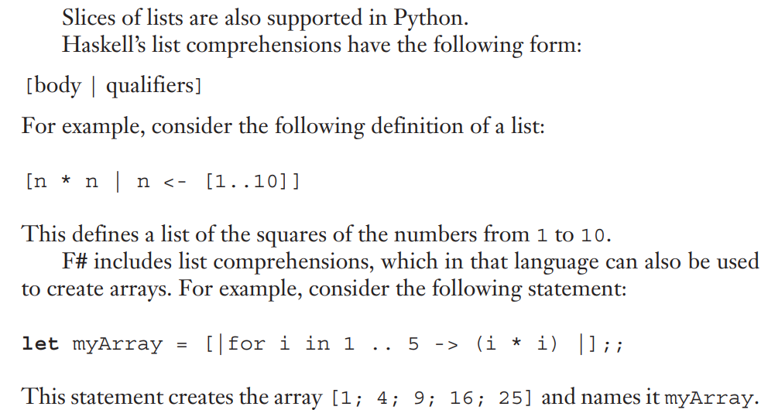

Slide 89
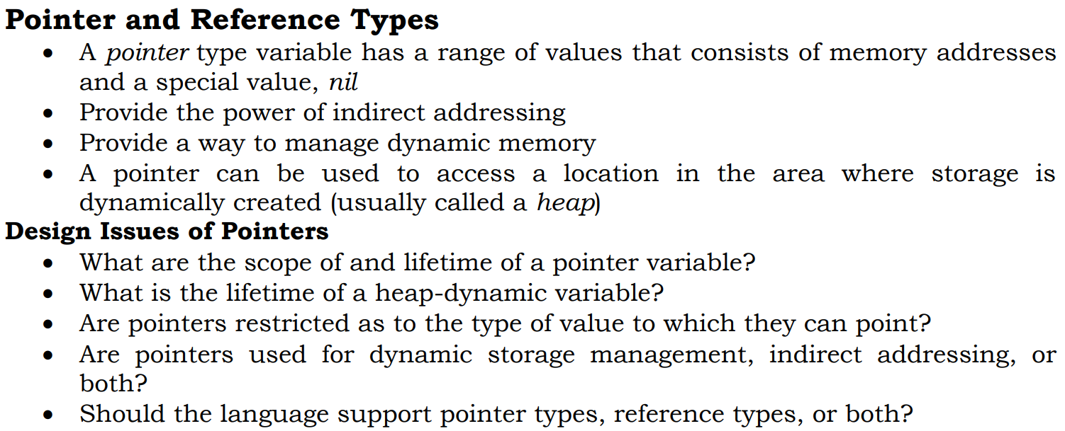
Pointer $ Reference Types

Slide 90
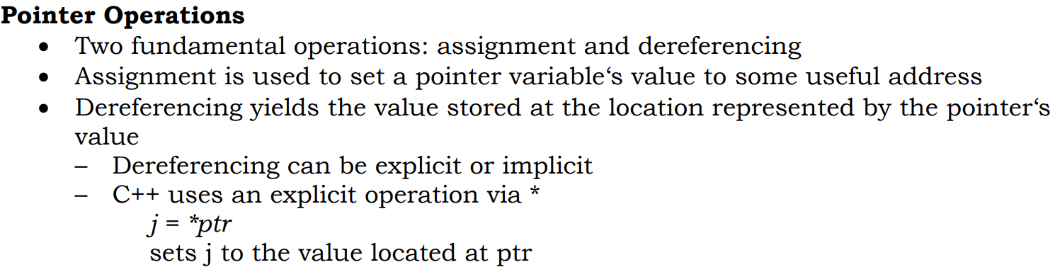

Slide 91
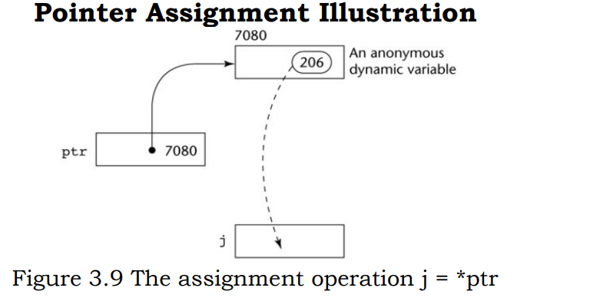

Slide 92
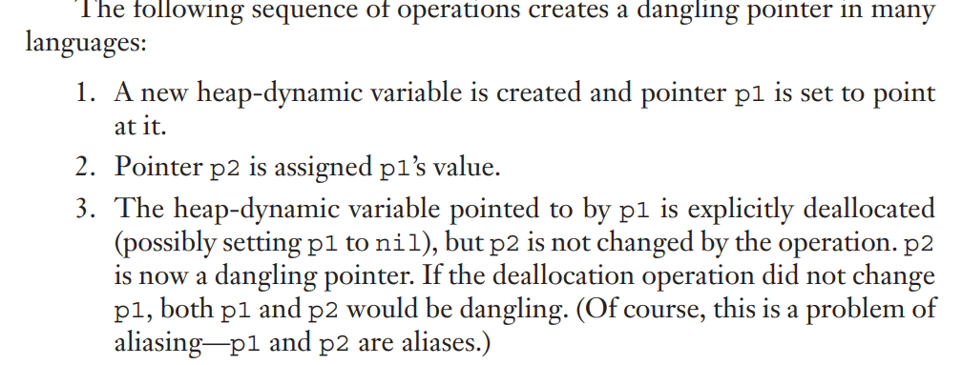
Dangling Pointers

Slide 93
Lost Heap-Dynamic Variables
A lost heap-dynamic variable is an allocated heap-dynamic variable that is no longer accessible to the user program.
Such variables are often called garbage, because they are not useful for their original purpose, and they also cannot be reallocated for some new use in the program.
Lost heap-dynamic variables are most often created by the following sequence of operations:
1. Pointer p1 is set to point to a newly created heap-dynamic variable.
2. p1 is later set to point to another newly created heap-dynamic variable.
The first heap-dynamic variable is now inaccessible, or lost. This is sometimes called memory leakage.
Memory leakage is a problem, regardless of whether the language uses implicit or explicit deallocation

Slide 94
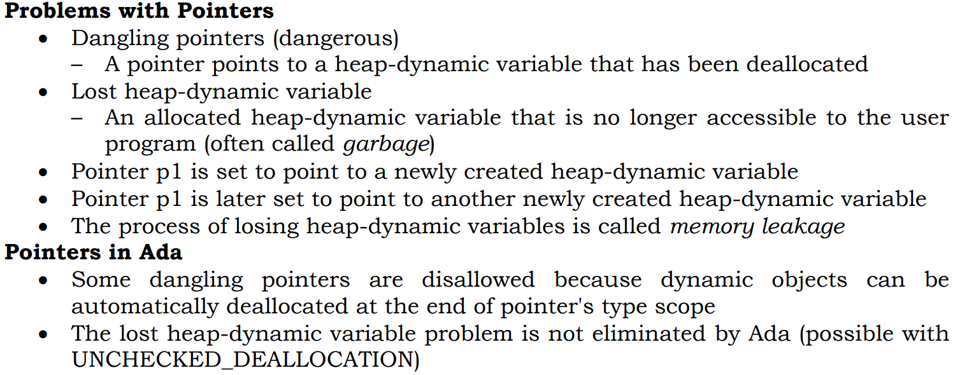

Slide 95
Solutions to the Dangling-Pointer Problem
Tombstones
Every heap-dynamic variable includes a special cell, called a tombstone, that is itself a pointer to the heap-dynamic variable.
The actual pointer variable points only at tombstones and never to heap-dynamic variables.
When a heap-dynamic variable is deallocated, the tombstone remains but is set to nil, indicating that the heap-dynamic variable no longer exists.
This approach prevents a pointer from ever pointing to a deallocated variable.
Any reference to any pointer that points to a nil tombstone can be detected as an error.

Slide 96
Tombstones are costly in both time and space. Because tombstones are never deallocated, their storage is never reclaimed.
Every access to a heap dynamic variable through a tombstone requires one more level of indirection, which requires an additional machine cycle on most computers.
Apparently none of the designers of the more popular languages have found the additional safety to be worth this additional cost, because no widely used language uses tombstone.

Slide 97
Locks-and-keys approach
Pointer values are represented as (key, address) pairs
Heap-dynamic variables are represented as variable plus cell for integer lock value
When heap-dynamic variable allocated, lock value is created and placed in lock cell and key cell of pointer
Every access to the dereferenced pointer compares the key value of the pointer to the lock value in the heap-dynamic variable.
If they match, the access is legal; otherwise the access is treated as a run-time error.
Any copies of the pointer value to other pointers must copy the key value.

Slide 98
Reference Types
A reference type variable is similar to a pointer, with one important and fundamental difference:
A pointer refers to an address in memory, while a reference refers to an object or a value in memory.
As a result, although it is natural to perform arithmetic on addresses, it is not sensible to do arithmetic on references.

Slide 99
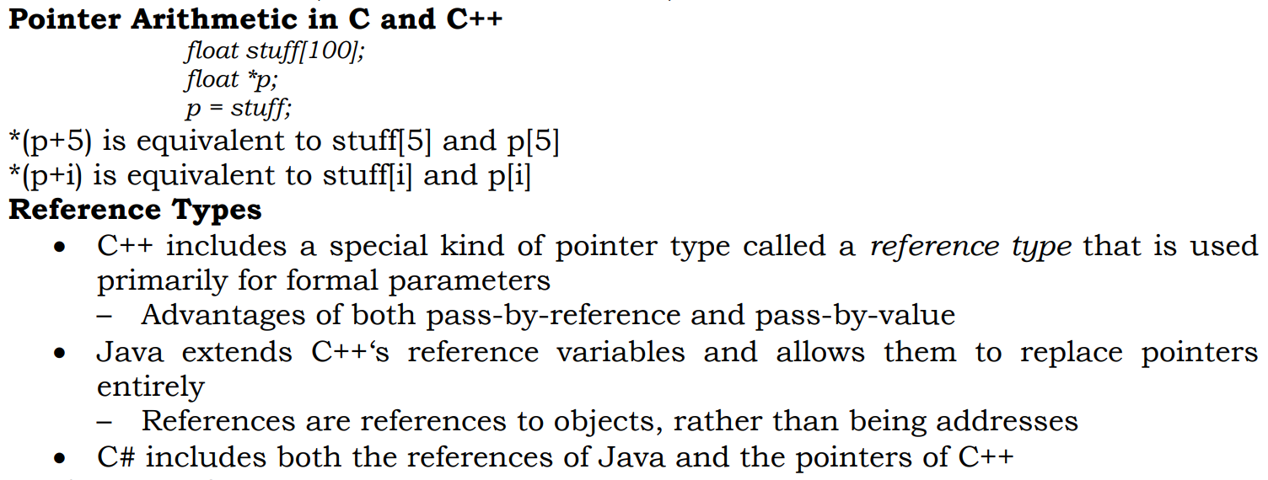

Slide 100
Heap Management
Garbage Collection
Language implementation notice when objects are no longer useful and reclaim them automatically
Two approaches to reclaim garbage
Reference counters (eager approach): reclamation is gradual
Mark-sweep (lazy approach): reclamation occurs when the list of variable space becomes empty

Slide 101
Reference counters
Maintains in every cell a counter that stores the number of pointers that are currently pointing at the cell.
Embedded in the decrement operation for the reference counters, which occurs when a pointer is disconnected from the cell, is a check for a zero value.
If the reference counter reaches zero, it means that no program pointers are pointing at the cell, and it has thus become garbage and can be returned to the list of available space.

Slide 102
Drawbacks
There are three distinct problems with the reference counter method:
If storage cells are relatively small, the space required for the counters is significant.
Some execution time is obviously required to maintain the counter values. Every time a pointer value is changed, the cell to which it was pointing must have its counter decremented, and the cell to which it is now pointing must have its counter incremented.
Complications arise when a collection of cells is connected circularly. The problem here is that each cell in the circular list has a reference counter value of at least 1, which prevents it from being collected and placed back on the list of available space

Slide 103
Advantage
Its actions are interleaved with those of the application, so it never causes significant delays in the execution of the application.

Slide 104
Mark & Sweep
Executed when the amount of free space in heap falls below some threshold
3 steps are executed by garbage collector
Collector walks through the heap, marking every block as useless
Collector recursively explores all linked data structures in the program marking each newly discovered block as useful
Collector again walks through the heap, moving every lock that is still marked useless to free list

Slide 105
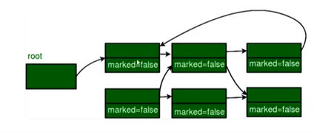
Mark and sweep

Slide 106
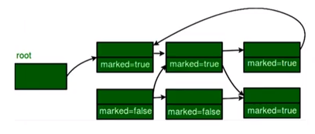

Slide 107
Disadvantages
In its original form, it was done too infrequently.
When done, it caused significant delays in application execution.
Contemporary marksweep algorithms avoid this by doing it more often—called incremental marksweep.

Slide 108
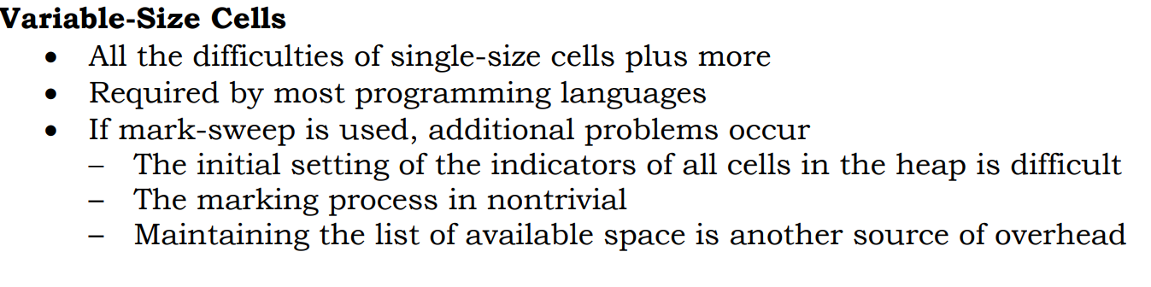

Slide 109
Type checking
Type checking is the activity of ensuring that the operands of an operator are of compatible types.
A compatible type is one that either is legal for the operator or is allowed under language rules to be implicitly converted by compiler-generated code (or the interpreter) to a legal type. This automatic conversion is called a coercion.
Eg: If an int variable and a float variable are added in Java, the value of the int variable is coerced to float and a floating-point addition is done.

Slide 110
A type error is the application of an operator to an operand of an inappropriate type.
Eg: In the original version of C, if an int value was passed to a function that expected a float value, a type error would occur
If all bindings of variables to types are static in a language, then type checking can nearly always be done statically.
Dynamic type binding requires type checking at run time, which is called dynamic type checking.
A programming language is strongly typed if type errors are always detected.

Slide 111
Ada is nearly strongly typed.
It is only nearly strongly typed because it allows programmers to breach the type-checking rules by specifically requesting that type checking be suspended for a particular type conversion.
It take place by extracting the value of a variable of one type and using it as if it were of a different type. This kind of conversion is sometimes called a nonconverting cast

Slide 112
Type Equivalence
The type compatibility rules are simple and rigid for the predefined scalar types.
However, in the cases of structured types, such as arrays and records and some user-defined types, the rules are more complex.
Coercion of these types is rare, so the issue is not type compatibility, but type equivalence
Two types are equivalent if an operand of one type in an expression is substituted for one of the other type, without coercion. Type equivalence is a strict form of type compatibility—compatibility without coercion.

Slide 113
Type Equivalence
Two types are considered same if they have
Name Equivalence
Structural Equivalence

Slide 114
Name Equivalence
Name Equivalence - Two types are equal if and only if they have same type name
typedef strct{
int data[100];
int count;
}stack;
typedef strct{
int data[100];
int count;
}set;

Slide 115
Stack x,y;
Set r,s;
Using name equivalance
x and y are of same type and r and s are of same type
But type of x and y will not be equivalent to r and s
i.e. X=y and r=s are valid but x=r is invalid

Slide 116
Structural Equivalence
Two types are equal if and only if they have same structure.
i.e name and types of each component must be same and must be listed in same order in type definition
Here 2 types stack and set can be considered equivalent i.e x=r is valid
Ada follows name equivalence and ML follows structural equivalence

Slide 117
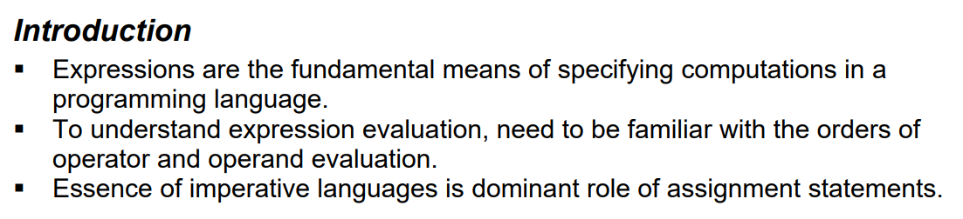
Expressions and Assignment Statements

Slide 118


Slide 119


Slide 120


Slide 121


Slide 122


Slide 123


Slide 124


Slide 125


Slide 126


Slide 127
Ruby Expressions
Recall that Ruby is a pure object-oriented language, which means, among other things, that every data value, including literals, is an object.
Ruby supports the collection of arithmetic and logic operations that are included in the C-based languages.
What sets Ruby apart from the C-based languages in the area of expressions is that all of the arithmetic, relational, and assignment operators, as well as array indexing, shifts, and bitwise logic operators, are implemented as methods.
For example, the expression a + b is a call to the + method of the object referenced by a, passing the object referenced by b as a parameter.

Slide 128
One interesting result of the implementation of operators as methods is that they can be overridden by application programs. Therefore, these operators can be redefined

Slide 129
Expressions in LISP
As is the case with Ruby, all arithmetic and logic operations in LISP are performed by subprograms.
But in LISP, the subprograms must be explicitly called. For example, to specify the C expression a + b * c in LISP, one must write the following expression:
(+ a (* b c))
In this expression, + and * are the names of functions

Slide 130


Slide 131
Operand Evaluation Order
The process:
1. Variables: just fetch the value from memory.
2. Constants: sometimes a fetch from memory; sometimes the constant is in the machine language instruction
3. If an operand is a parenthesized expression, all of the operators it contains must be evaluated before its value can be used as an operand.

Slide 132
Side Effects (IMP)
A side effect of a function, naturally called a functional side effect, occurs when the function changes either one of its parameters or a global variable.
(A global variable is declared outside the function but is accessible in the function.)
Consider the expression a + fun(a)
If fun does not have the side effect of changing a, then the order of evaluation of the two operands, a and fun(a), has no effect on the value of the expression.
However, if fun changes a, there is an effect.

Slide 133
Consider the following situation: fun returns 10 and changes the value of its parameter to 20
Suppose we have the following:
a = 10; b = a + fun(a);
Then, if the value of a is fetched first (in the expression evaluation process), its value is 10 and the value of the expression is 20.
But if the second operand is evaluated first, then the value of the first operand is 20 and the value of the expression is 30.

Slide 134


Slide 135

Solutions

Slide 136
Referential Transparency
A program has the property of referential transparency if any two expressions in the program that have the same value can be substituted for one another anywhere in the program, without affecting the action of the program.
The value of a referentially transparent function depends entirely on its parameters
Eg:
result1 = (fun(a) + b) / (fun(a) - c); temp = fun(a);
result2 = (temp + b) / (temp - c);
If the function fun has no side effects, result1 and result2 will be equal, because the expressions assigned to them are equivalent

Slide 137
However, suppose fun has the side effect of adding 1 to either b or c.
Then result1 would not be equal to result2. So, that side effect violates the referential transparency of the program in which the code appears.

Slide 138

Overloaded Operators

Slide 139
When sensibly used, user-defined operator overloading can aid readability.
For example, if + and * are overloaded for a matrix abstract data type and A, B, C, and D are variables of that type,
then A * B + C * D
can be used instead of
MatrixAdd(MatrixMult(A, B), MatrixMult(C, D)
On the other hand, user-defined overloading can be harmful to readability.
For one thing, nothing prevents a user from defining + to mean multiplication

Slide 140
Another consideration is the process of building a software system from modules created by different groups.
If the different groups overloaded the same operators in different ways, these differences would obviously need to be eliminated before putting the system together.

Slide 141

Type Conversions

Slide 142


Slide 143

Explicit Type Conversions

Slide 144
Errors in Expressions
Caused by: – Inherent limitations of arithmetic e.g. division by zero
Limitations of computer arithmetic e.g. overflow or underflow
Floating-point overflow and underflow, and division by zero are examples of run-time errors, which are sometimes called exceptions.

Slide 145
Relational and Boolean Expressions
A relational operator is an operator that compares the values of its two operands.
A relational expression has two operands and one relational operator.
The value of a relational expression is Boolean, except when Boolean is not a type included in the language.
The relational operators are often overloaded for a variety of types
Operator symbols used vary somewhat among languages (!=, /=, .NE., <>, #)

Slide 146


Slide 147

Boolean Expressions

Slide 148

Short Circuit Evaluation

Slide 149


Slide 150

Assignment Statements

Slide 151


Slide 152


Slide 153


Slide 154


Slide 155

Mixed-Mode Assignment

Slide 156


